Slide 1

Stock Information Web Interface
FE520 Final Project (Group 27)
By-
Prashant Mall
CWID: 10459371

Slide 2
What does the web app do?
Display historical Stock Data on a single page web application
Gives the user option to type in and search for specific Stock listed in the market
Fetch stock historical data from Yahoo Finances
Store a local copy in SQL DB for offline access and analysis
Interactive graph with features to analyze stock data

Slide 3
Technologies Used
Python to write the webserver using Flask web framework
Flask is a micro web framework written in Python
HTML, CSS and JS along with Flask Templating to build the front end of the application
Highcharts for data visualization for graphs
Panda for modifying the raw data received from Yahoo Finance
PostgreSQL to store modified data locally

Slide 4
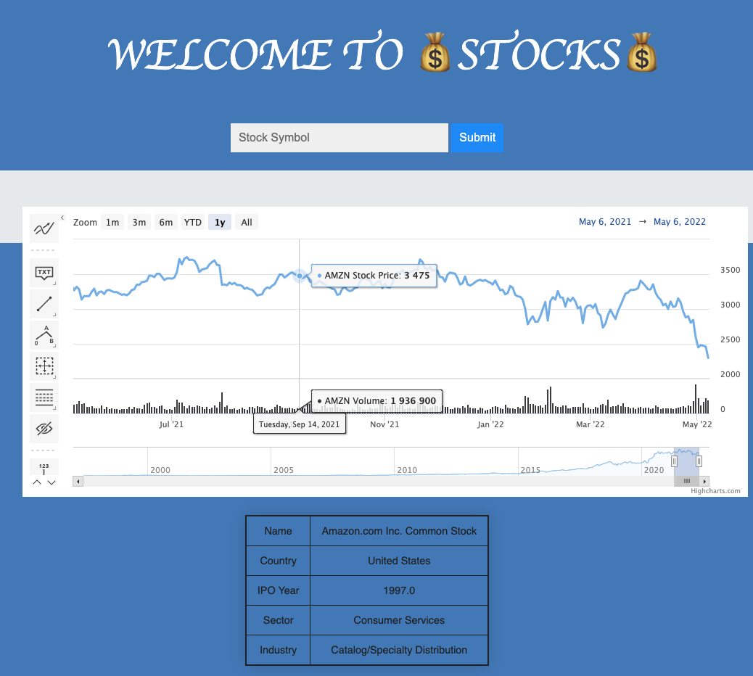
Result
The website is a single page application to display historical stock data
The user can search for different stocks by typing in the stock symbol
The search auto-populates the list as the user types
The page also shows few other basic information about the company

Slide 5
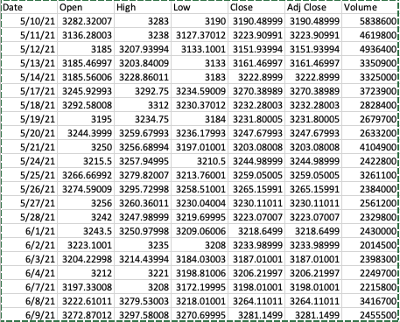
How does the raw CSV data look?
The CSV file is automatically downloaded from Yahoo Finances using the ‘yfinance’ pip module
This data is stored in a panda data frame initially
Column ‘Adj Close’ is removed as Highcharts does not take that into account
The data frame is further modified to format data to be better stored in SQL DB

Slide 6
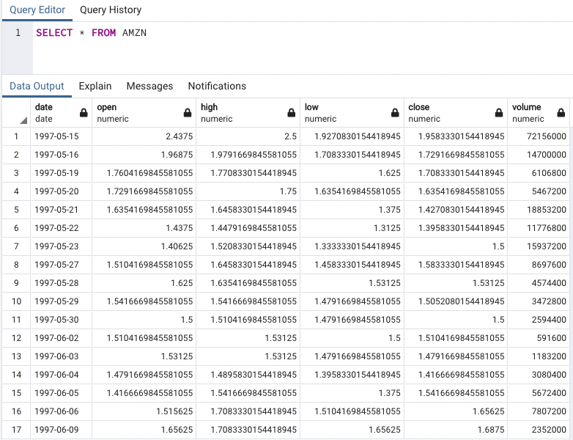
Data stored in PostgreSQL DB
Items in data column are stored in date format for easier calculation
All other columns are in numeric data format

Slide 7
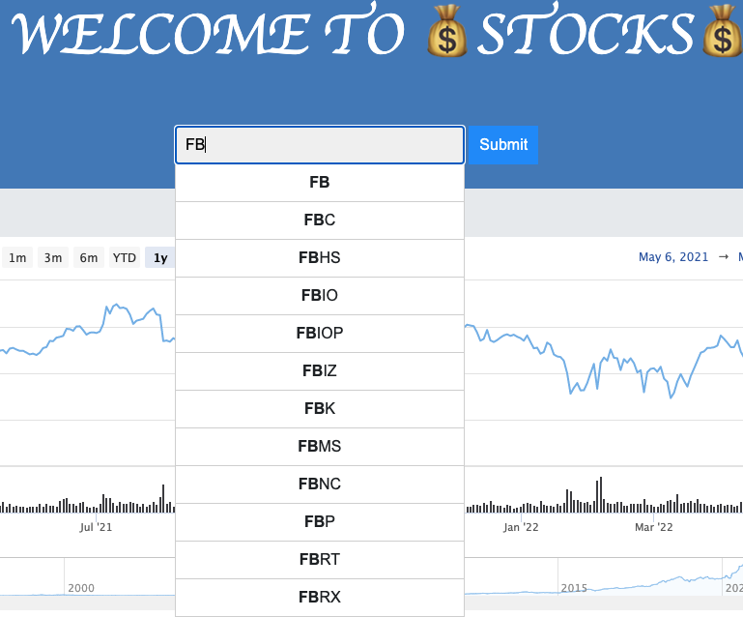
Autofill
The search autocompletes the stock symbol name
This is implemented to ease the search and reduce errors
The stock list is populated from NASDAQ Stock Screener

Slide 8
Challenges
First and foremost, I had to learn flask from scratch and get familiar with the framework
I had to research to find suitable data and visualization tools for the project
Handling bad data or bad user input
Linking the front end and making routers work as intended

Slide 9
Thank You

